Slide 1
CCA Manual of Mechanics for the 2 Umpire System
2025 Edition

Slide 2
Instructional Plan for the CCA Manual
Mechanics Philosophy
Section 2: Parts 1, 2, and 4 for the two-umpire system, and Part 3 for the three-umpire system
Section 3: Parts 1, 2, and 4 for High School baseball
Section 4: Parts 1 and 2
Section 5: Parts 1-6
Mechanics Diagrams and Instructions:
Section 7: All Parts
Section 8: All Parts
Signal Chart Pages 280 and 281
Notes:
If I had an entire three-day camp to go over everything in this book, I would still be short of covering all of the ins and outs. So we are going to cover some highlights, and then deep dive into some of the more nuanced stuff.
The first few sections, which I am highlighting are the Mechanics Philosophy, that is the mechanical guidelines necessary for properly implementing CCA Mechanics. If you understand the philosophies, you’ll understand the mechanic diagrams and instructions.
Section 2 covers the points of emphasis, and the parts I have listed correlate to either all systems, or the respective two/three umpire system.
Section 3 covers the conduct and ethics of umpiring, and while it is more applicable to college ball, I think that parts 1, 2, and 4 are really good ways to officiate. Essentially, most of Section 3 can be boiled down to “You don’t have to be an asshole unless the rulebook calls for it.”
Section 3 part 4 and Section 4 part 2 go hand-in-hand, re-emphasizing the importance of umpires keeping their calm even as the coach is crossing the line.
Section 4 Part 1 is good for helping with the understanding of when and how calls should be emphasized.
Section 5 is important for understanding why we take the positions we take, and why it is important to have good communication with your partner.
The second couple of sections are Mechanic Diagrams and Instructions, and this is where we get into rotations, initial coverage, responsibilities, and judgement points for the two and three umpire systems.
Section 7 covers the two umpire system
Section 8 covers the three umpire system

Slide 3
Section 2 Emphasis
2.1 Fly Ball Reads — All Umpire Systems
Pause, read, react. Do not be too quick to give up coverage of fly balls, esp. in two-umpire system.
If in doubt, go out, but only use this if the ball is hit too hard, and doesn’t allow enough time for a true read.
Order of priorities is 1) fair/foul 2) catch/no catch 3)base touches and other base actions.
Pause, read, and react; get the best angle to determine catch/no catch and fair/foul
2.2 Catch, No-Catch on the Infield — All Umpire Systems
While we have diagrams of who is responsible for catch/no catch, sometimes these have to be abandoned in the name of getting the call right.
COMMUNICATE WITH YOUR PARTNER(S)!!!
Help your partner on unlikely calls, and work as a crew to make the right call

Slide 4
Section 2 Emphasis
2.4 Movements from the C Position — Two-Umpire System
R3, 2 outs, ball hit to the infield, the most likely play is at first base.
Read R3, then move as far as possible towards 1st. Make sure that you read which fielder has the ball, and clear the throwing lane.
The quicker you can do this, the better
The most likely play on the infield with 2 Outs is at first base, so work to get that call correct

Slide 5
Section 3 Emphasis
3.1 Character
Leave it on the field, leave it in the locker room, and leave it in the past. Do not retaliate.
Take pride in what you do, be honest in your mistakes, and open to feedback from your peers, your instructors, and your assignor.
Jealousy has never gotten anyone a better game or better break.
Do what is defensible, have some integrity, and be aware of how you will look on camera.
3.2 Conduct and Ethics
Have some respect for yourself and for others
Look the part, be the part
Know rules, mechanics, and umpiring philosophies, and know how and when to use each one.
Be respectful to players, coaches, and admin.
Take accountability for your actions
Don’t do stuff that could get you fired
3.4 Coach/Umpire Philosophy
The expectation of behavior is higher for us than it is for coaches. Anything you say can and will be used against you in a conversation later.
Stay Calm
Watch what you say, the words you use, and when you say them
Be careful of how you use your hands
We are held to a higher standard by CIF, the unit, coaches, and parents than anyone else on the field.
Notes:
Remember, we are private contractors, which means that we can get asked to not come back, and that is not a protected right.

Slide 6
Section 4 Emphasis
4.1 Style and Form of Calls
You can have a personalized style of mechanics, but there are certain fundamentals that you need to have in every call.
Give a signal on all calls except “ball” and obvious catch of fly balls.
Make your signals crisp, clear, and visible. Make sure everyone can hear you on verbal calls.
Make sure that your calls are decisive. Timing is everything.
As a play gets “closer” (aka more pressure) your call should get more emphatic.
When possible, make your call with you head and body still, and your body facing the play prior to turning to your next responsibility (exceptions will occur)
Use your voice and your mechanics to sell your calls

Slide 7
Section 4 Emphasis
4.2 Handling Situations
There’s a fine line between “moving the game along” and making a situation worse.
Remain calm, impartial, tactful, firm, and fair. Do not use your position as an excuse to be an asshole, and don’t be condescending.
Let the coach hang himself out to dry. You do not have to have the last word, chase a coach down, or have a cold-shoulder demeanor. Be respectful without being a pushover.
Do not initiate an argument or physical contact with a coach.
Know when to interject, and when to let your partner handle a situation. Remember, you are a crew, so act like one.
Let the coaches eject themselves. Do your best to not be the aggressor.
Notes:
EJ of Assistant Coach Video

Slide 8
Section 5 Emphasis
5.1 Mechanics Philosophies/Basic Concepts
Umpire mechanics are a series of compromises.
Base coverage and mechanics are based on the most likely play to happen next.
Mechanics should not be based on unlikely second or third play developments.
Mechanics should not be based on limiting the amount of effort an umpire must exert.*
The crew needs to work together to cover the entire field of play without limiting the workload of any one umpire.*
*Exception here is for those who can no longer comfortably get out of the “A” position in two-man.
Ease of effort is not an excuse for poor mechanics. The players work hard, so we work hard.
Situation awareness is important. Knowing where the runners are at the end of each play is important.
5.2 Basic Starting Positions
Know where you need to start based on umpire system and position of the runner(s)
Know the rules, especially the balk rules
5.3 General Balk Responsibilities
See a balk, call a balk!
Notes:
Call Out of Position Video

Slide 9
Section 5 Emphasis
5.4 Rundown Plays
Work to get an angle on the tag for rundowns. The umpire with the best angle should make the call.
Work Rundowns as a crew
5.5 Positioning for Taking Plays
The diagrams show movement and starting points, not where you need to end up to take a play. This is important when taking all factors of a play into consideration. Use your best judgment in finding your position
Do not umpire to a spot, find the appropriate angle to see all aspects of the play.
5.6 Crew Pregame Meeting
The crew chief/plate umpire** should conduct a pre-game meeting with the crew before going on the field, and a post-game debrief when coming off.
**If you are working with a senior umpire, and you are unsure how to run a pre-game and post-game, have that umpire run it.
Always pre-game and post-game with your partner/crew. Every game is an opportunity to improve.

Slide 10






















Play Diagram Key Terms
Plate umpire
First-base umpire
Second-base umpire
Third-base umpire
Right-field umpire
Left-field umpire
Judgment point
Pause
Batter-runner
Runner on first
Runner on second
Runner on third
Ball movement
No runners on
Runner on first
Runners on first and second
Runners on first, second and third
Runners on first and third
Runner on second
Runners on second and third
Runner on third

Slide 11
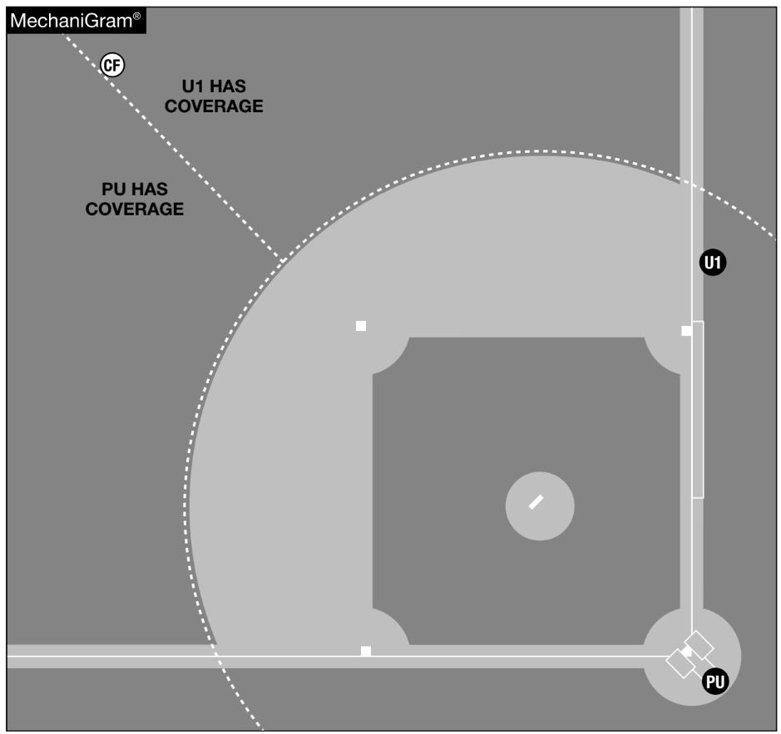
Fly Ball and Fair/Foul Coverage in 2 Umpire System

Slide 12



CF
U1 HAS COVERAGE
PU HAS COVERAGE
U1
U1
PU
PU
Fly Ball and Fair/Foul with No One On 2 Umpires

Slide 13





RF
PU COVERAGE
CF
U1 COVERAGE
R1
U1
R1
U1
LF
PU COVERAGE
PU
PU
Fly Ball and Fair/Foul with Runners on Base 2 Umpires

Slide 14
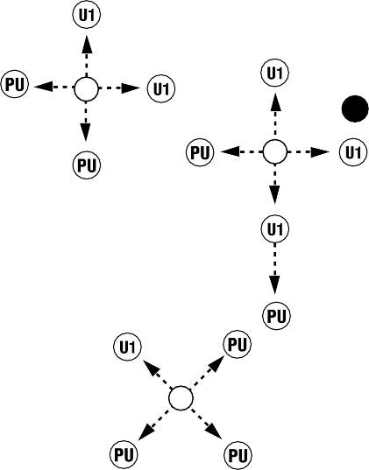












U1
2B
U1
2B
U1
U1
1B
PU
U1
U1
R1
U1
1B
PU
U1
SS
U1
U1
SS
U1
U1
PU
U1
U1
P
P
PU
PU
3B
PU
3B
U1
PU
PU
PU
No one on base
Runners on base
Infield Fly Ball Coverage 2 Umpires

Slide 15



Pick Offs and Steals
R1
R1
U3
THROW
BR

Slide 16



R1
U1
R1
R1
PICKOFF THROW
U1
THROW
U1
U1
BR
PU
PU
Pick Off by Pitcher (Not Shown in CCA)
Throwdown by Catcher (7.6.5 CCA pp. 59)
2 Umpire System Coverage

Slide 17
R1
R1
R1
U3
PICKOFF THROW
U3
THROW
BR
Pick Off by Pitcher (8.7.4 CCA pp. 120)
Throwdown by Catcher (8.7.5 CCA pp. 121)
3 Umpire System Coverage

Slide 18









Rotations On the Infield
THROW
R1
R1
U1
U1
BR
THROW
PU
PU
GROUND BALL
BR
PU

Slide 19














U1
U1
U1
U1
BR
U1
THROW
BR
OVERTHROW
PU
PU
PU
GROUND BALL
GROUND BALL
BR
BR
PU
PU
True throw (7.5.4 CCA pp. 46)
Overthrow (7.5.5 CCA pp. 47)
Infield rotations with no one on base

Slide 20





THROW
STEAL
R1
R1
R1
U1
U1
BR
U1
U1
BR
U1
THROW
THROW
THROW
PU
PU
GROUND BALL
R1
PU
BR
PU
GROUND BALL
BR
PU
Routine Double Play (7.6.4 CCA pp. 58)
Hit and Run Play (7.6.7 CCA pp. 61)
Infield rotations with R1 Only

Slide 21







BR
BR
R1
R1
U1
OVERTHROW
U1
OVERTHROW
R1
U1
R1
U1
PU
PU
GROUND BALL
PU
PU
GROUND BALL
BR
PU
BR
PU
Original 7.6.6 CCA Diagram pp. 60.
Updated Diagram to Reflect Rotation as Described on pp. 60.
Infield rotations with R1 Only

Slide 22










R1
BR
BR
R1
R1
R2
THROW
U1
OVERTHROW
U1
THROW
U1
GROUND BALL
U1
R1
GROUND BALL
PU
BR
R3
R3
PU
R2
PU
BR
PU
Runners on 1st and 2nd (7.7.2 CCA pp. 70)
Runners on 1st and 3rd (7.9.1 CCA pp. 81)
Infield rotation with R1 and a Runner in Scoring Position

Slide 23











BR
R2
R2
THROW
BR
U1
U1
THROW
THROW
GROUND BALL
GROUND BALL
U1
R2
BR
BR
R3
PU
PU
R2 Only (7.10.1 CCA pp. 87)
R2 and R3 (7.11.1 CCA pp. 93)
Infield rotation with Runners in Scoring position, no force play

Slide 24


Rotations on Fly Balls and Base Hits
CLEAN HIT
U1
No Runners
BR
U1
PU
BR
PU

Slide 25


CLEAN HIT
CLEAN HIT
U1
U1
BR
U1
PU
BR
U1
PU
BR
PU
BR
PU
Base Hit, BR Holds at 1st (7.5.6 CCA pp. 48)
Clean Hit, Extra Bases (7.5.7 CCA pp. 49)
Base Hit with no Runners

Slide 26


RF
CATCH
U1
U1
BR
NO CATCH
U1
LF
PU
BR
U1
PU
BR
BR
PU
PU
PU
Catch, BR towards 2nd (7.5.10 CCA pp. 52)
No Catch, Play into 3rd (7.5.11 CCA pp. 53)
Pop Up/Fly Ball with no Runners

Slide 27

NO CATCH
RF
NO CATCH
RF
U1
U1
U1
U1
U1
BR
PU
PU
PU
BR
PU
BR
BR
U1
PU
No Catch, Double (7.5.8 CCA pp. 50)
No Catch, Play at the Plate (7.5.9 CCA pp. 51)
Trouble Ball with No Runners

Slide 28
Rotations on Fly Balls and Base Hits
CLEAN HIT
U1
Runner on First
BR
U1
PU
BR
PU

Slide 29






BR
R1
U1
U1
BR
R1
U1
U1
LF
CLEAN HIT
LF
CLEAN HIT
R1
PU
PU
THROW
PU
BR
BR
PU
OVERTHROW
R1
PU
Clean Hit, Play at 3rd (7.6.8 CCA pp. 62)
Clean Hit, Play at Home (7.6.9 CCA pp. 63)
Clean Hit with R1

Slide 30


CATCH
CF
BR
R1
R1
R1
R1
U1
U1
U1
BR
U1
LF
CATCH
BR
PU
BR
PU
PU
PU
Catch Called by U1 (7.6.11 CCA pp. 65)
Catch Called by PU (7.6.12 CCA pp. 66)
Routine Fly Ball Coverage with R1

Slide 31


RF
NO CATCH
THROW
RF
NO CATCH
THROW
BR
R1
BR
R1
U1
U1
PU
PU
R1
U1
R1
U1
BR
PU
BR
PU
Fair/Foul Decision (7.6.10 CCA pp. 64)
Trouble Ball, non-Fair/Foul (7.6.13 CCA pp. 67)
Trouble On the Right Field Line with R1

Slide 32
Rotations on Fly Balls and Base Hits
CLEAN HIT
U1
Runners at 1st and 2nd, Runners at 1st, 2nd, and 3rd, and Runners at 1st and 3rd
BR
U1
PU
BR
PU

Slide 33
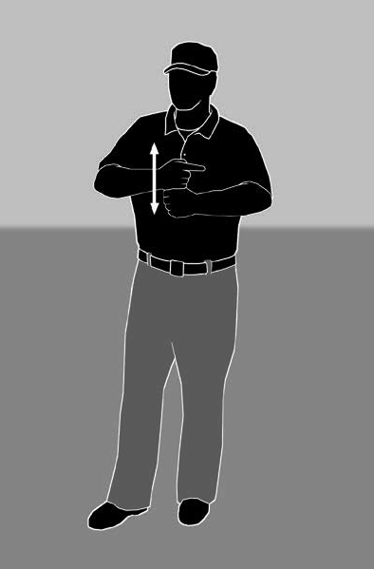
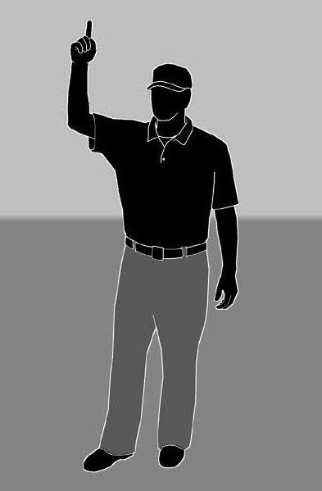

CATCH
CF
THROW
R1
R1
BR
R2
U1
U1
R2
PU
Double Tag Rotation
Infield Fly
BR
PU
Rotation with 2 Umpires (7.7.4 CCA pp. 72)
The Double Tag Rotation (R1 and R2, Less than 2 Outs)

Slide 34


RF
CATCH
CF
THROW
BR
R1
BR
R1
R2
U1
R1
R2
LF
U1
LF
THROW
U1
NO CATCH
R1
PU
R2
U1
R2
PU
BR _{PU}
BR _{PU}
Ball hit to left field (7.7.5 CCA pp. 73)
Ball hit to right field (7.7.6 CCA pp. 74)
Fair/Foul with R1 and R2

Slide 35


RF
RF
CLEAN HIT
THROW
THROW
CLEAN HIT
BR R1
BR
R1
R2
R2
U1
U1
R1
U1
R1
U1
BR
R3
R2
BR
R3
R2
PU
PU
PU
PU
Clean hit with R1 and R2 (7.7.3 CCA pp. 71)
Clean hit with R1, R2, and R3 (7.8.1 CCA pp. 76)
Base hit with runners in scoring position

Slide 36


CLEAN HIT
RF
CATCH
CF
THROW
THROW
_{R1} BR
BR
R1
R1
U1
U1
U1
U1
R1
PU
BR
BR
R3
R3
R3
R3
PU
PU
PU
PU
Clean Hit (7.9.2 CCA pp. 82)
Caught Fly Ball (7.9.3 CCA pp. 83)
Rotations with R1 and R3

Slide 37


NO CATCH
CF
THROW
BR
R1
R1
BR
R1
U1
U1
U1
U1
LF
PU
THROW
R1
CATCH
BR
_{PU} R3
R3
R3
BR
R3
PU
PU
Ball hit to left field (7.9.4 CCA pp. 84)
Ball hit to right field (7.9.5 CCA pp. 85)
Fair/Foul with R1 and R3

Slide 38
Rotations on Fly Balls and Base Hits
CLEAN HIT
U1
Runners in Scoring Position, no R1
BR
U1
PU
BR
PU

Slide 39



RF
THROW
CLEAN HIT
RF
CLEAN HIT
THROW
BR
BR
R2
R2
U1
U1
U1
BR
BR
R2
R3
R3
PU
R2
PU
Clean hit with R2 only (7.10.2 CCA pp. 88)
Clean hit with R2 and R3 (7.11.2 CCA pp. 94)
Base hit with runners in scoring position

Slide 40


RF
CATCH
CF
THROW
CATCH
THROW
BR
BR
R2
U1
R2
LF
U1
LF
U1
U1
R2
R2
U1
BR
R3
R3
PU
BR
PU
PU
PU
R2 Only (7.10.3 CCA pp. 89)
R2 and R3 (7.11.3 CCA pp. 95)
Observing Tag-Ups with Runners in Scoring Position
Notes:
1 Out Timing Play Video

Slide 41


RF
RF
CATCH
CF
THROW
FLY BALL
CF
BR
BR
R2
R2
LF
LF
U1
U1
CATCH
R2
PU
U1
R2
U1
PU
BR _{PU}
BR
PU
Fly ball to left field (7.10.4 CCA pp. 90)
Fly ball to right field (7.10.5 CCA pp. 91)
Fair/Foul with R2 Only

Slide 42



RF
CATCH
THROW
BR
BR
R2
R2
U1
R2
U1
LF
U1
U1
R2
PU
THROW
CATCH
BR
R3
R3
BR
R3
PU
R3
PU
PU
Fly ball to left field (7.11.4 CCA pp. 96)
Fly ball to right field (7.11.5 CCA pp. 97)
Fair/Foul with R2 and R3

Slide 43

CATCH
CF
RF
THROW
CATCH
BR
BR
THROW
U1
U1
U1
U1
R3
BR
PU
BR
R3
R3
PU
PU
R3
PU
Routine Fly Ball (7.12.1 CCA pp. 100)
Fair/Foul Decision (7.12.2-3 CCA pp. 101-2)
R3 Only Situations

Slide 44
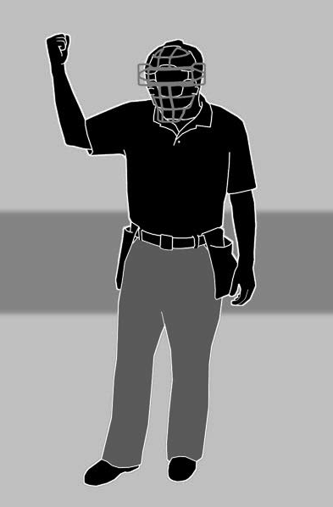
Umpire Signals
Strike

Slide 45
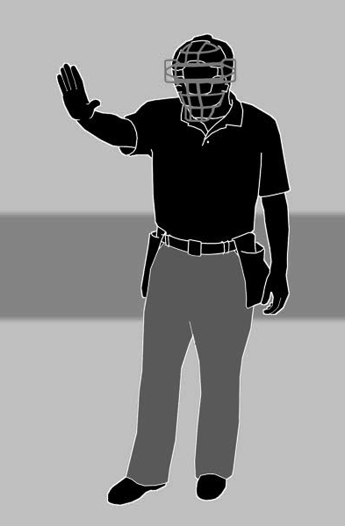
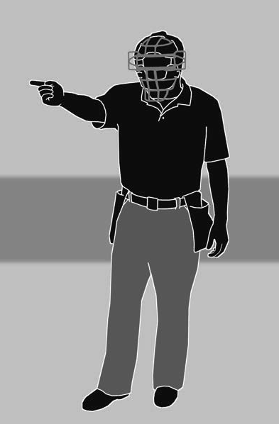
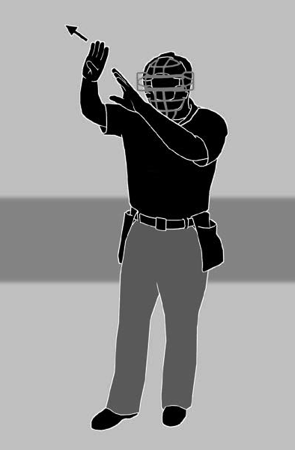
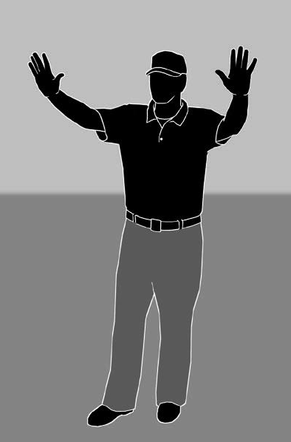
Do not pitch; ball is dead
Play
Strike
Foul Tip
Infield Fly
Time out or dead ball

Slide 46
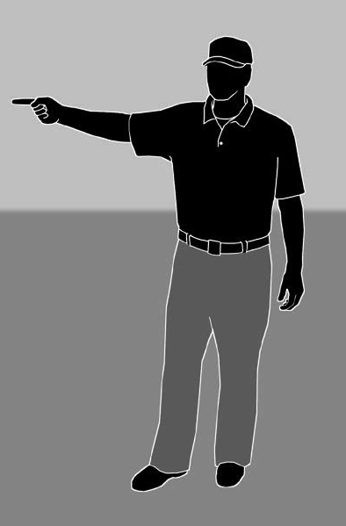
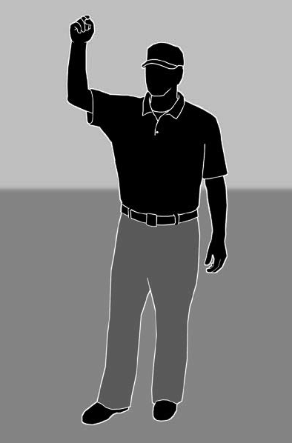
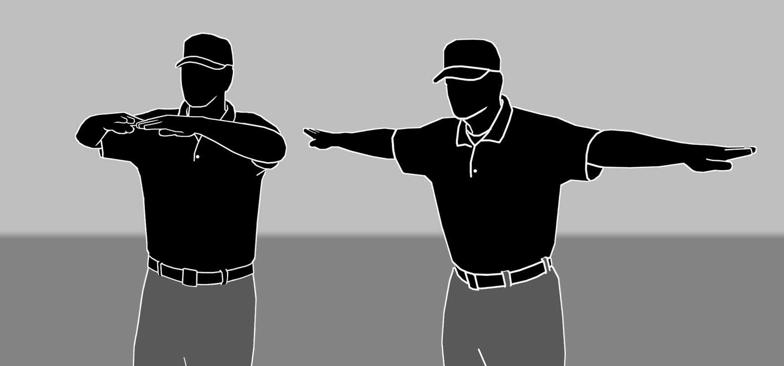
Fair Ball
Out
Safe

